Slide 1
Beyond binary classification
David Kauchak CS 158 – Fall 2023

Slide 2
Admin
Assignment 4
Assignment 2 graded

Slide 3
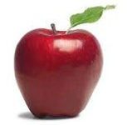

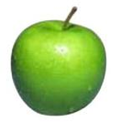
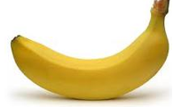
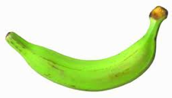

Multiclass classification
examples
label
Same setup where we have a set of features for each example
Rather than just two labels, now have 3 or more
apple
orange
apple
banana
real-world examples?
banana
pineapple

Slide 4
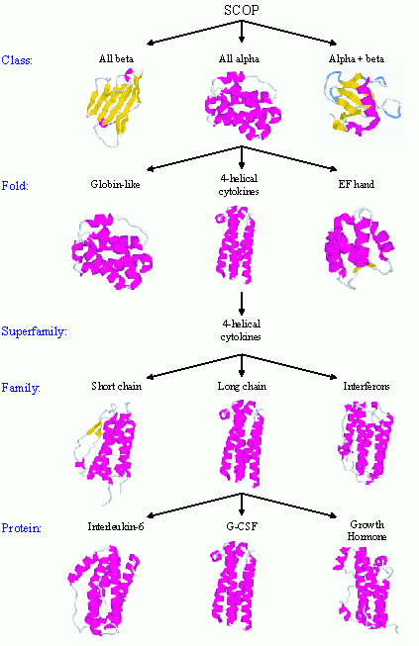
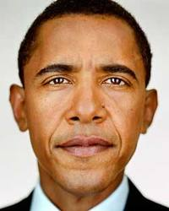

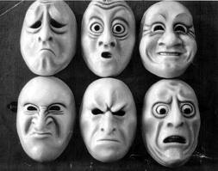

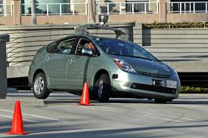
Real world multiclass classification
handwriting recognition
protein classification
face recognition
document classification
most real-world applications tend to be multiclass
emotion recognition
sentiment analysis
autonomous vehicles

Slide 5
Multiclass: current classifiers
Any of these work out of the box?
With small modifications?

Slide 6
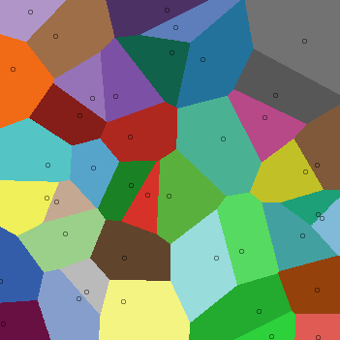
k-Nearest Neighbor (k-NN)
To classify an example d:
Find k nearest neighbors of d
Choose as the label the majority label within the k nearest neighbors
No algorithmic changes!

Slide 7
Decision Tree learning
Base cases:
If all data belong to the same class, pick that label
If all the data have the same feature values, pick majority label
If we’re out of features to examine, pick majority label
If the we don’t have any data left, pick majority label of parent
If some other stopping criteria exists to avoid overfitting, pick majority label
Otherwise:
calculate the “score” for each feature if we used it to split the data
pick the feature with the highest score, partition the data based on that data value and call recursively
No algorithmic changes!

Slide 8
Perceptron learning
Hard to separate three classes with just one line ☹

Slide 9
Black box approach to multiclass
Abstraction: we have a generic binary classifier, how can we use it to solve our new problem
+1
binary classifier
optionally: also output a confidence/score
-1
Can we solve our multiclass problem with this?

Slide 10
Approach 1: One vs. all (OVA)
Training: for each label L, pose as a binary problem
all examples with label L are positive
all other examples are negative
apple vs. not
orange vs. not
banana vs. not
apple
+1
-1
-1
orange
-1
+1
-1
apple
+1
-1
-1
banana
-1
-1
+1
banana
-1
-1
+1

Slide 11
OVA: linear classifiers (e.g. perceptron)
banana vs. not
pineapple vs. not
apple vs. not

Slide 12
OVA: linear classifiers (e.g. perceptron)
banana vs. not
pineapple vs. not
apple vs. not
How do we classify?

Slide 13
OVA: linear classifiers (e.g. perceptron)
banana vs. not
pineapple vs. not
apple vs. not
How do we classify?

Slide 14
OVA: linear classifiers (e.g. perceptron)
banana vs. not
pineapple vs. not
apple vs. not
How do we classify?

Slide 15
OVA: linear classifiers (e.g. perceptron)
banana vs. not
pineapple vs. not
apple vs. not
How do we classify?

Slide 16
OVA: linear classifiers (e.g. perceptron)
none?
banana OR pineapple
banana vs. not
pineapple vs. not
apple vs. not
How do we classify?

Slide 17
OVA: linear classifiers (e.g. perceptron)
banana vs. not
pineapple vs. not
apple vs. not
How do we classify?

Slide 18
OVA: classify
Classify:
If classifier doesn’t provide confidence (this is rare) and there is ambiguity, pick one of the ones in conflict
Otherwise:
pick the most confident positive
if none vote positive, pick least confident negative

Slide 19
OVA: linear classifiers (e.g. perceptron)
banana vs. not
pineapple vs. not
What does the decision boundary look like?
apple vs. not

Slide 20
OVA: linear classifiers (e.g. perceptron)
PINEAPPLE
APPLE
BANANA

Slide 21
OVA: classify, perceptron
Classify:
If classifier doesn’t provide confidence (this is rare) and there is ambiguity, pick majority in conflict
Otherwise:
pick the most confident positive
if none vote positive, pick least confident negative
How do we calculate this for the perceptron?

Slide 22
OVA: classify, perceptron
Classify:
If classifier doesn’t provide confidence (this is rare) and there is ambiguity, pick majority in conflict
Otherwise:
pick the most confident positive
if none vote positive, pick least confident negative
Distance from the hyperplane

Slide 23
Approach 2: All vs. all (AVA)
Training:
For each pair of labels, train a classifier to distinguish between them
for i = 1 to number of labels:
for k = i+1 to number of labels:
train a classifier to distinguish between label_{j} and label_{k}:
- create a dataset with all examples with label_{j} labeled positive and all examples with label_{k} labeled negative
- train classifier on this subset of the data

Slide 24
AVA training visualized
apple vs orange
orange vs banana
+1
apple
+1
-1
orange
+1
-1
-1
apple
apple vs banana
banana
+1
banana
+1
-1
-1

Slide 25
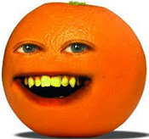
AVA classify
apple vs orange
+1
orange
+1
orange vs banana
-1
+1
apple vs banana
orange
-1
What class?
+1
-1
+1
apple
-1
-1

Slide 26
AVA classify
apple vs orange
+1
orange
+1
orange vs banana
-1
+1
apple vs banana
orange
orange
-1
+1
-1
+1
apple
In general?
-1
-1

Slide 27
AVA classify
To classify example e, classify with each classifier f_{jk}
We have a few options to choose the final class:
Take a majority vote
Take a weighted vote based on confidence
y = f_{jk}(e)
score_{j} += y
score_{k} -= y
How does this work?
Here we’re assuming that y encompasses both the prediction (+1,-1) and the confidence, i.e. y = prediction * confidence.

Slide 28
AVA classify
Take a weighted vote based on confidence
y = f_{jk}(e)
score_{j} += y
score_{k} -= y
If y is positive, classifier thought it was of type j:
- raise the score for j
- lower the score for k
if y is negative, classifier thought it was of type k:
- lower the score for j
- raise the score for k

Slide 29
OVA vs. AVA
Train/classify runtime?
Error? Assume each binary classifier makes an error with probability ε

Slide 30
OVA vs. AVA
Train time:
AVA learns more classifiers, however, they’re trained on much smaller data this tends to make it faster if the labels are equally balanced
Test time:
AVA has more classifiers, so often it is slower
Error (see the book for more justification):
AVA trains on more balanced data sets
AVA tests with more classifiers and therefore has more chances for errors
- Theoretically:
-- OVA: ε (number of labels -1)
-- AVA: 2 ε (number of labels -1)

Slide 31
Approach 3: Divide and conquer
vs
vs
vs
Pros/cons vs. AVA?
Notes:
less classifiers during training
less classifiers to make a mistake during testing
have to choose with examples to group together (and this can impact performance)

Slide 32
Multiclass summary
If using a binary classifier, the most common thing to do is OVA
Otherwise, use a classifier that allows for multiple labels:
DT and k-NN work reasonably well
We’ll see a few more in the coming weeks that will often work better

Slide 33
Multiclass evaluation
label
prediction
apple
orange
orange
orange
How should we evaluate?
apple
apple
banana
pineapple
banana
banana
pineapple
pineapple

Slide 34
Multiclass evaluation
label
prediction
apple
orange
orange
orange
Accuracy: 4/6
apple
apple
banana
pineapple
banana
banana
pineapple
pineapple

Slide 35
Multiclass evaluation imbalanced data
label
prediction
apple
orange
…
Any problems?
apple
apple
banana
pineapple
Data imbalance!
banana
banana
pineapple
pineapple
Notes:
- could try and do precision/recall for each class, but there can be lots of classes

Slide 36
Macroaveraging vs. microaveraging
microaveraging: average over examples (this is the “normal” way of calculating)
macroaveraging: calculate evaluation score (e.g. accuracy) for each label, then average over labels
What effect does this have?
Why include it?

Slide 37
Macroaveraging vs. microaveraging
microaveraging: average over examples (this is the “normal” way of calculating)
macroaveraging: calculate evaluation score (e.g. accuracy) for each label, then average over labels
Puts more weight/emphasis on rarer labels
Allows another dimension of analysis

Slide 38
Macroaveraging vs. microaveraging
label
prediction
microaveraging: average over examples
macroaveraging: calculate evaluation score (e.g. accuracy) for each label, then average over labels
apple
orange
orange
orange
apple
apple
banana
pineapple
banana
banana
?
pineapple
pineapple

Slide 39
Macroaveraging vs. microaveraging
label
prediction
microaveraging: 4/6
macroaveraging:
apple = 1/2
orange = 1/1
banana = 1/2
pineapple = 1/1
total = (1/2 + 1 + 1/2 + 1)/4
= 3/4
apple
orange
orange
orange
apple
apple
banana
pineapple
banana
banana
pineapple
pineapple

Slide 40
Confusion matrix
entry (i, j) represents the number of examples with label i that were predicted to have label j
another way to understand both the data and the classifier
 | Classic | Country | Disco | Hiphop | Jazz | Rock
Classic | 86 | 2 | 0 | 4 | 18 | 1
Country | 1 | 57 | 5 | 1 | 12 | 13
Disco | 0 | 6 | 55 | 4 | 0 | 5
Hiphop | 0 | 15 | 28 | 90 | 4 | 18
Jazz | 7 | 1 | 0 | 0 | 37 | 12
Rock | 6 | 19 | 11 | 0 | 27 | 48
Notes:
what do the entries along the diagonal represent?

Slide 41
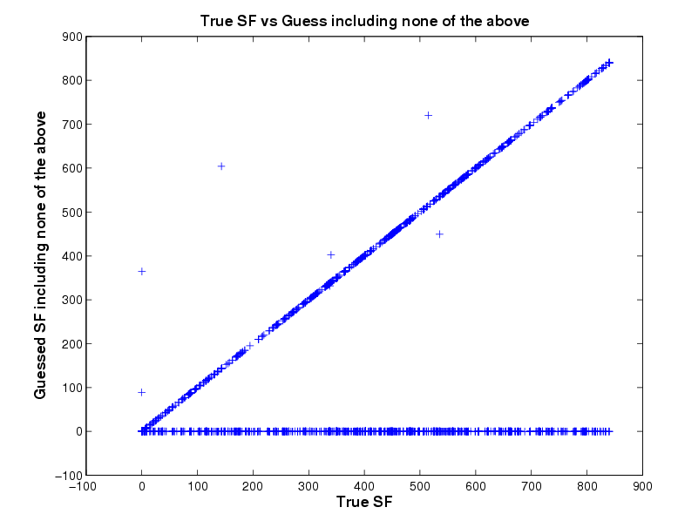
Confusion matrix
BLAST classification of proteins in 850 superfamilies

Slide 42
Multilabel vs. multiclass classification
Is it edible?
Is it sweet?
Is it a fruit?
Is it a banana?
Is it a banana?
Is it an apple?
Is it an orange?
Is it a pineapple?
Is it a banana?
Is it yellow?
Is it sweet?
Is it round?
Any difference in these labels/categories?

Slide 43
Multilabel vs. multiclass classification
Is it edible?
Is it sweet?
Is it a fruit?
Is it a banana?
Is it a banana?
Is it an apple?
Is it an orange?
Is it a pineapple?
Is it a banana?
Is it yellow?
Is it sweet?
Is it round?
Different structures
Nested/ Hierarchical
Exclusive/ Multiclass
General/Structured

Slide 44
Multiclass vs. multilabel
Multiclass: each example has one label and exactly one label
Multilabel: each example has zero or more labels. Also called annotation
Multilabel applications?

Slide 45
Multilabel
Image annotation
Document topics
Labeling people in a picture
Medical diagnosis

Slide 46
Ranking problems
Suggest a simpler word for the word below:
vital

Slide 47
Suggest a simpler word
Suggest a simpler word for the word below:
vital
word | frequency
important | 13
necessary | 12
essential | 11
needed | 8
critical | 3
crucial | 2
mandatory | 1
required | 1
vital | 1

Slide 48
Suggest a simpler word
Suggest a simpler word for the word below:
acquired

Slide 49
Suggest a simpler word
Suggest a simpler word for the word below:
acquired
word | frequency
gotten | 12
received | 9
gained | 8
obtained | 5
got | 3
purchased | 2
bought | 2
got hold of | 1
acquired | 1

Slide 50
Suggest a simpler word
vital
acquired
important
necessary
essential
needed
critical
crucial
mandatory
required
vital
gotten
received
gained
obtained
got
purchased
bought
got hold of
acquired
…
training data
train
list of synonyms
ranker
list ranked by simplicity

Slide 51
Ranking problems in general
ranking1
ranking2
ranking3
f₁, f₂, …, f_{n}
f₁, f₂, …, f_{n}
f₁, f₂, …, f_{n}
training data:
a set of rankings where each ranking consists of a set of ranked examples
f₁, f₂, …, f_{n}
f₁, f₂, …, f_{n}
f₁, f₂, …, f_{n}
…
f₁, f₂, …, f_{n}
f₁, f₂, …, f_{n}
f₁, f₂, …, f_{n}
f₁, f₂, …, f_{n}
f₁, f₂, …, f_{n}
f₁, f₂, …, f_{n}
train
f₁, f₂, …, f_{n}
f₁, f₂, …, f_{n}
ranker
ranking/ordering or examples
f₁, f₂, …, f_{n}
f₁, f₂, …, f_{n}

Slide 52
Ranking problems in general
ranking1
ranking2
ranking3
f₁, f₂, …, f_{n}
f₁, f₂, …, f_{n}
f₁, f₂, …, f_{n}
training data:
a set of rankings where each ranking consists of a set of ranked examples
f₁, f₂, …, f_{n}
f₁, f₂, …, f_{n}
f₁, f₂, …, f_{n}
…
f₁, f₂, …, f_{n}
f₁, f₂, …, f_{n}
f₁, f₂, …, f_{n}
f₁, f₂, …, f_{n}
f₁, f₂, …, f_{n}
f₁, f₂, …, f_{n}
Real-world ranking problems?

Slide 53

Netflix Recommender

Slide 54
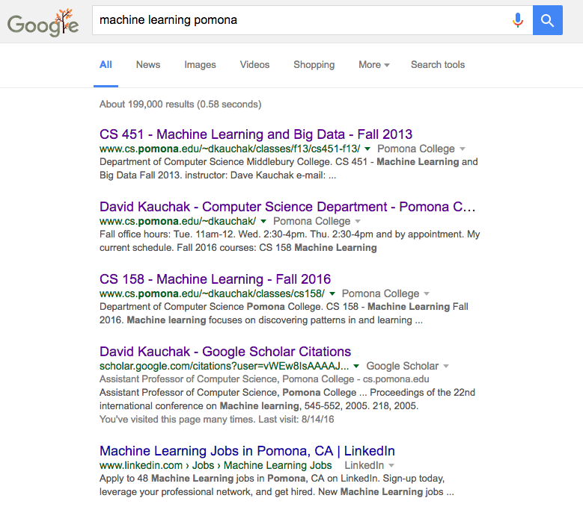
Search

Slide 55
Ranking Applications
Reranking N-best output lists
machine translation
computational biology
parsing
…
flight search
…

Slide 56
Black box approach to ranking
Abstraction: we have a generic binary classifier, how can we use it to solve our new problem
+1
binary classifier
optionally: also output a confidence/score
-1
Can we solve our ranking problem with this?

Slide 57
Predict better vs. worse
Train a classifier to decide if the first input is better than second:
- Consider all possible pairings of the examples in a ranking
- Label as positive if the first example is higher ranked, negative otherwise
ranking1
f₁, f₂, …, f_{n}
f₁, f₂, …, f_{n}
f₁, f₂, …, f_{n}

Slide 58
Predict better vs. worse
Train a classifier to decide if the first input is better than second:
- Consider all possible pairings of the examples in a ranking
- Label as positive if the first example is higher ranked, negative otherwise
new examples
binary label
f₁, f₂, …, f_{n}
f₁, f₂, …, f_{n}
+1
+1
-1
+1
-1
-1
ranking1
f₁, f₂, …, f_{n}
f₁, f₂, …, f_{n}
f₁, f₂, …, f_{n}
f₁, f₂, …, f_{n}
f₁, f₂, …, f_{n}
f₁, f₂, …, f_{n}
f₁, f₂, …, f_{n}
f₁, f₂, …, f_{n}
f₁, f₂, …, f_{n}
f₁, f₂, …, f_{n}
f₁, f₂, …, f_{n}
f₁, f₂, …, f_{n}
f₁, f₂, …, f_{n}

Slide 59
Predict better vs. worse
+1
Our binary classifier only takes one example as input
binary classifier
-1

Slide 60
Predict better vs. worse
+1
Our binary classifier only takes one example as input
binary classifier
-1
a₁, a₂, …, a_{n}
b₁, b₂, …, b_{n}
f’₁, f’₂, …, f’_{n’}
How can we do this?
We want features that compare the two examples.

Slide 61
Combined feature vector
Many approaches! Will depend on domain and classifier
Two common approaches:
difference:
greater than/less than:

Slide 62
Training
new examples
label
f₁, f₂, …, f_{n}
f₁, f₂, …, f_{n}
extract features
f’₁, f’₂, …, f’_{n’}
+1
+1
-1
+1
-1
-1
train classifier
f₁, f₂, …, f_{n}
f₁, f₂, …, f_{n}
f’₁, f’₂, …, f’_{n’}
binary classifier
f₁, f₂, …, f_{n}
f₁, f₂, …, f_{n}
f’₁, f’₂, …, f’_{n’}
f₁, f₂, …, f_{n}
f₁, f₂, …, f_{n}
f’₁, f’₂, …, f’_{n’}
f₁, f₂, …, f_{n}
f₁, f₂, …, f_{n}
f’₁, f’₂, …, f’_{n’}
f₁, f₂, …, f_{n}
f₁, f₂, …, f_{n}
f’₁, f’₂, …, f’_{n’}

Slide 63
Testing
binary classifier
unranked
f₁, f₂, …, f_{n}
ranking?
f₁, f₂, …, f_{n}
f₁, f₂, …, f_{n}

Slide 64
Testing
extract features
f’₁, f’₂, …, f’_{n’}
f₁, f₂, …, f_{n}
f₁, f₂, …, f_{n}
unranked
f₁, f₂, …, f_{n}
f₁, f₂, …, f_{n}
f’₁, f’₂, …, f’_{n’}
f₁, f₂, …, f_{n}
f₁, f₂, …, f_{n}
f₁, f₂, …, f_{n}
f’₁, f’₂, …, f’_{n’}
f₁, f₂, …, f_{n}
f₁, f₂, …, f_{n}
f₁, f₂, …, f_{n}
f’₁, f’₂, …, f’_{n’}
f₁, f₂, …, f_{n}
f₁, f₂, …, f_{n}
f₁, f₂, …, f_{n}
f’₁, f’₂, …, f’_{n’}
f₁, f₂, …, f_{n}
f₁, f₂, …, f_{n}
f’₁, f’₂, …, f’_{n’}

Slide 65
Testing
extract features
f’₁, f’₂, …, f’_{n’}
-1
-1
+1
+1
-1
+1
f₁, f₂, …, f_{n}
f₁, f₂, …, f_{n}
f₁, f₂, …, f_{n}
f₁, f₂, …, f_{n}
f’₁, f’₂, …, f’_{n’}
f₁, f₂, …, f_{n}
f₁, f₂, …, f_{n}
f’₁, f’₂, …, f’_{n’}
binary classifier
f₁, f₂, …, f_{n}
f₁, f₂, …, f_{n}
f’₁, f’₂, …, f’_{n’}
f₁, f₂, …, f_{n}
f₁, f₂, …, f_{n}
f’₁, f’₂, …, f’_{n’}
f₁, f₂, …, f_{n}
f₁, f₂, …, f_{n}
f’₁, f’₂, …, f’_{n’}

Slide 66
Testing
f₁, f₂, …, f_{n}
f₁, f₂, …, f_{n}
-1
-1
+1
+1
-1
+1
f₁, f₂, …, f_{n}
f₁, f₂, …, f_{n}
f₁, f₂, …, f_{n}
f₁, f₂, …, f_{n}
What is the ranking?
Algorithm?
f₁, f₂, …, f_{n}
f₁, f₂, …, f_{n}
f₁, f₂, …, f_{n}
f₁, f₂, …, f_{n}
f₁, f₂, …, f_{n}
f₁, f₂, …, f_{n}

Slide 67
Testing
for each binary example e_{jk}:
label[j] += f_{jk}(e_{jk})
label[k] -= f_{jk}(e_{jk})
rank according to label scores
f₁, f₂, …, f_{n}
f₁, f₂, …, f_{n}
-1
-1
+1
+1
-1
+1
f₁, f₂, …, f_{n}
f₁, f₂, …, f_{n}
f₁, f₂, …, f_{n}
f₁, f₂, …, f_{n}
f₁, f₂, …, f_{n}
f₁, f₂, …, f_{n}
f₁, f₂, …, f_{n}
f₁, f₂, …, f_{n}
f₁, f₂, …, f_{n}
f₁, f₂, …, f_{n}
f₁, f₂, …, f_{n}
f₁, f₂, …, f_{n}
f₁, f₂, …, f_{n}

Slide 68
An improvement?
new examples
binary label
f₁, f₂, …, f_{n}
f₁, f₂, …, f_{n}
+1
+1
-1
+1
-1
-1
ranking1
f₁, f₂, …, f_{n}
f₁, f₂, …, f_{n}
f₁, f₂, …, f_{n}
f₁, f₂, …, f_{n}
f₁, f₂, …, f_{n}
f₁, f₂, …, f_{n}
f₁, f₂, …, f_{n}
f₁, f₂, …, f_{n}
f₁, f₂, …, f_{n}
f₁, f₂, …, f_{n}
f₁, f₂, …, f_{n}
f₁, f₂, …, f_{n}
f₁, f₂, …, f_{n}
Are these two examples the same?

Slide 69
Weighted binary classification
new examples
weighted label
f₁, f₂, …, f_{n}
f₁, f₂, …, f_{n}
+1
+2
-1
+1
-2
-1
ranking1
f₁, f₂, …, f_{n}
f₁, f₂, …, f_{n}
f₁, f₂, …, f_{n}
f₁, f₂, …, f_{n}
f₁, f₂, …, f_{n}
f₁, f₂, …, f_{n}
f₁, f₂, …, f_{n}
f₁, f₂, …, f_{n}
f₁, f₂, …, f_{n}
f₁, f₂, …, f_{n}
f₁, f₂, …, f_{n}
f₁, f₂, …, f_{n}
f₁, f₂, …, f_{n}
Weight based on distance in ranking

Slide 70
Weighted binary classification
new examples
weighted label
f₁, f₂, …, f_{n}
f₁, f₂, …, f_{n}
+1
+2
-1
+1
-2
-1
ranking1
f₁, f₂, …, f_{n}
f₁, f₂, …, f_{n}
f₁, f₂, …, f_{n}
f₁, f₂, …, f_{n}
f₁, f₂, …, f_{n}
f₁, f₂, …, f_{n}
f₁, f₂, …, f_{n}
f₁, f₂, …, f_{n}
f₁, f₂, …, f_{n}
f₁, f₂, …, f_{n}
f₁, f₂, …, f_{n}
f₁, f₂, …, f_{n}
f₁, f₂, …, f_{n}
In general can weight with any consistent distance metric
Can we solve this problem?

Slide 71
Testing
If the classifier outputs a confidence, then we’ve learned a distance measure between examples
During testing we want to rank the examples based on the learned distance measure
Ideas?

Slide 72
Testing
If the classifier outputs a confidence, then we’ve learned a distance measure between examples
During testing we want to rank the examples based on the learned distance measure
Sort the examples and use the output of the binary classifier as the similarity between examples!

Slide 73
Ranking evaluation
ranking
prediction
1
2
3
4
5
1
3
2
5
4
f₁, f₂, …, f_{n}
f₁, f₂, …, f_{n}
f₁, f₂, …, f_{n}
f₁, f₂, …, f_{n}
f₁, f₂, …, f_{n}
Ideas?

Slide 74
Idea 1: accuracy
ranking
prediction
1
2
3
4
5
1
3
2
5
4
f₁, f₂, …, f_{n}
f₁, f₂, …, f_{n}
1/5 = 0.2
f₁, f₂, …, f_{n}
f₁, f₂, …, f_{n}
f₁, f₂, …, f_{n}
Any problems with this?
Notes:
- doesn’t capture near m

Slide 75
Doesn’t capture “near” correct
ranking
prediction
prediction
1
2
3
4
5
1
3
2
5
4
1
5
4
3
2
f₁, f₂, …, f_{n}
f₁, f₂, …, f_{n}
f₁, f₂, …, f_{n}
f₁, f₂, …, f_{n}
f₁, f₂, …, f_{n}
1/5 = 0.2
Notes:
- doesn’t capture near m

Slide 76
Idea 2: correlation
ranking
prediction
prediction
1
2
3
4
5
1
3
2
5
4
1
5
4
3
2
Look at the correlation between the ranking and the prediction
Notes:
- doesn’t capture near m

